Slide 1
Feature Engineering and Variable and Transformation

Slide 2
Learning Goals
In this section, we will cover:
- Feature engineering and variable transformation
- Feature encoding
- Feature scaling

Slide 3
Transforming Data: Background
Models used in Machine Learning Workflows often make assumptions about the data.
A common example is the linear regression model.
This assumes a linear relationship between observations and target (outcome) variables.

Slide 4
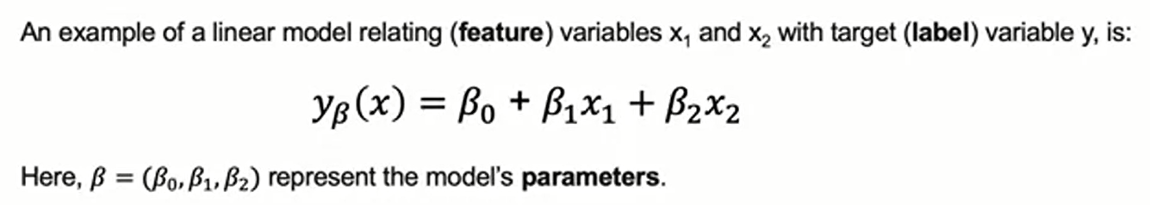
Transforming Data: Background

Slide 5
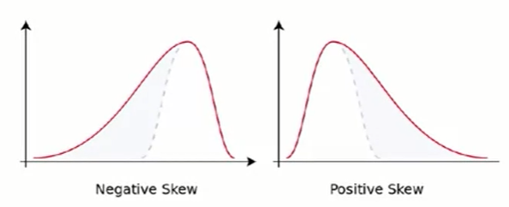
Transformation of Data Distributions
Predictions from linear regression models assume residuals are normally distributed.
Features and predicted data are often skewed (distorted away from the center).
Data transformations can solve this issue.

Slide 6
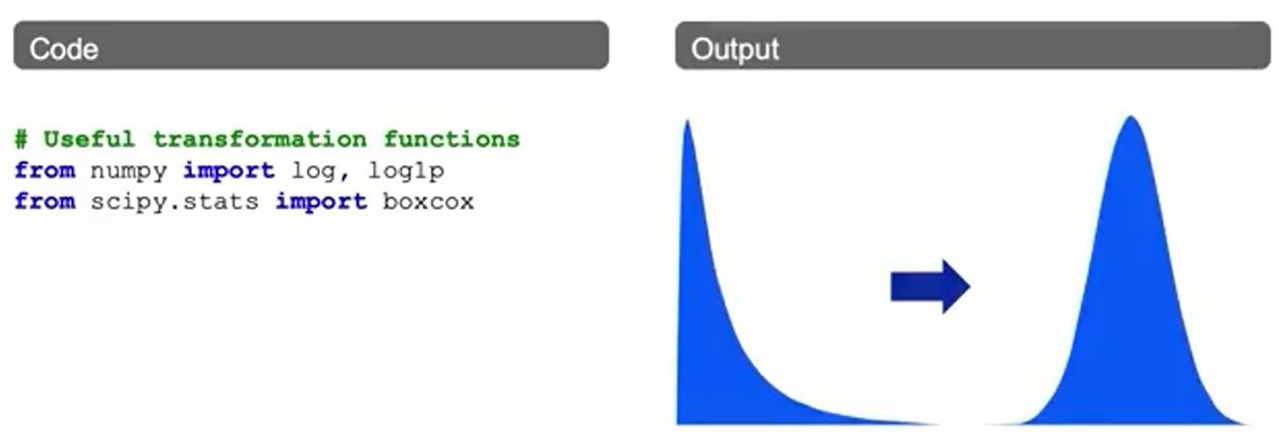
Transformation of Data Distributions

Slide 7
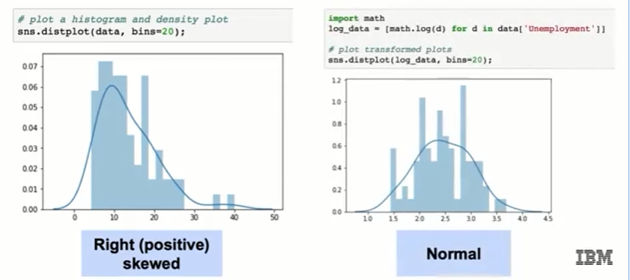
Log Transformation Example

Slide 8
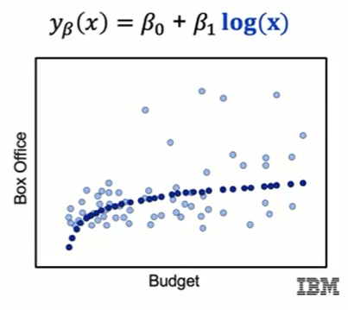
Transformations: Log Features
Log transformations can be useful for linear regression.
The linear regression model involves linear combinations of features.

Slide 9
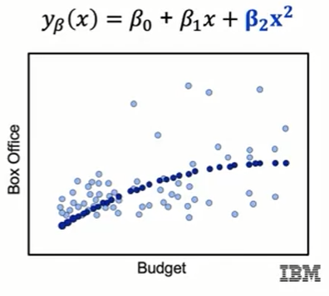
Transformations: Polynomial Features
We can estimate higher-order relationships in this data by adding polynomial features.
This allows us to use the same 'linear' model.

Slide 10
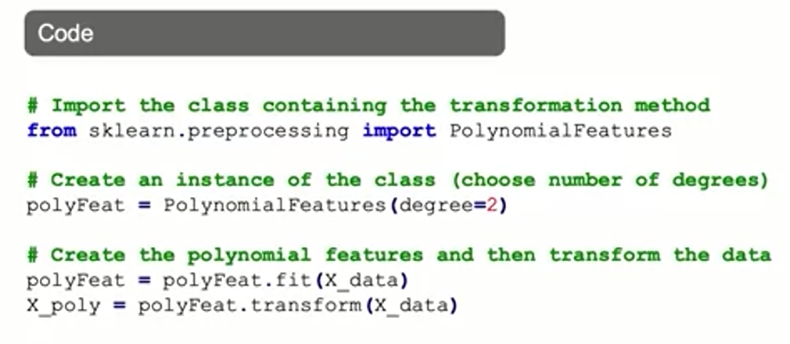
Polynomial Features: Syntax

Slide 11
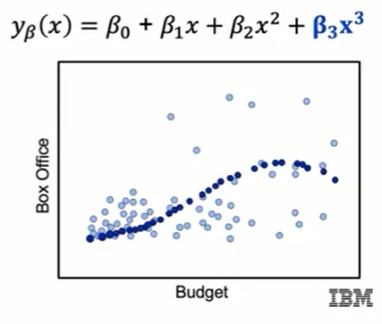
Transformations: Polynomial Features
We can estimate higher-order relationships in this data by adding polynomial features.
This allows us to use the same 'linear' model.
Even with higher-order polynomials.

Slide 12
Variable Selection: Background
Variable selection involves choosing the set of features to include in the model.
Variables must often be transformed before they can be included in models.
In addition to log and polynomial transformations, this can involve:
- Encoding: converting non-numeric features to numeric features.
- Scaling: converting the scale of numeric data so they are comparable.
The appropriate method of scaling or encoding depends on the type of feature.

Slide 13
Feature Encoding: Types of Features
Encoding is often applied to categorical features, that take non-numeric values. Two primary types:
- Nominal: categorical variables take values in unordered categories
(e.g. Red, Blue, Green; True, False).
- Ordinal: categorical variables take values in ordered categories
(e.g. High, Medium, Low).

Slide 14
Feature Encoding: Approaches
There are several common approaches to encoding variables:
- Binary encoding: converts variables to either 0 or 1 and is suitable for variables that take two possible values (e.g. True, False).
- One-hot encoding: converts variables that take multiple values into binary (0, 1) variables, one for each category. This creates several new variables.
- Ordinal encoding: involves converting ordered categories to numerical values, usually by creating one variable that takes integer equal to the number of categories (e.g. 0, 1, 2, 3, ...).

Slide 15
Feature Scaling: Background
Feature scaling involves adjusting a variable's scale.
This allows comparison of variables with different scales.
Different continuous (numeric) features often have different scales.
Why might this be an issue?

Slide 16
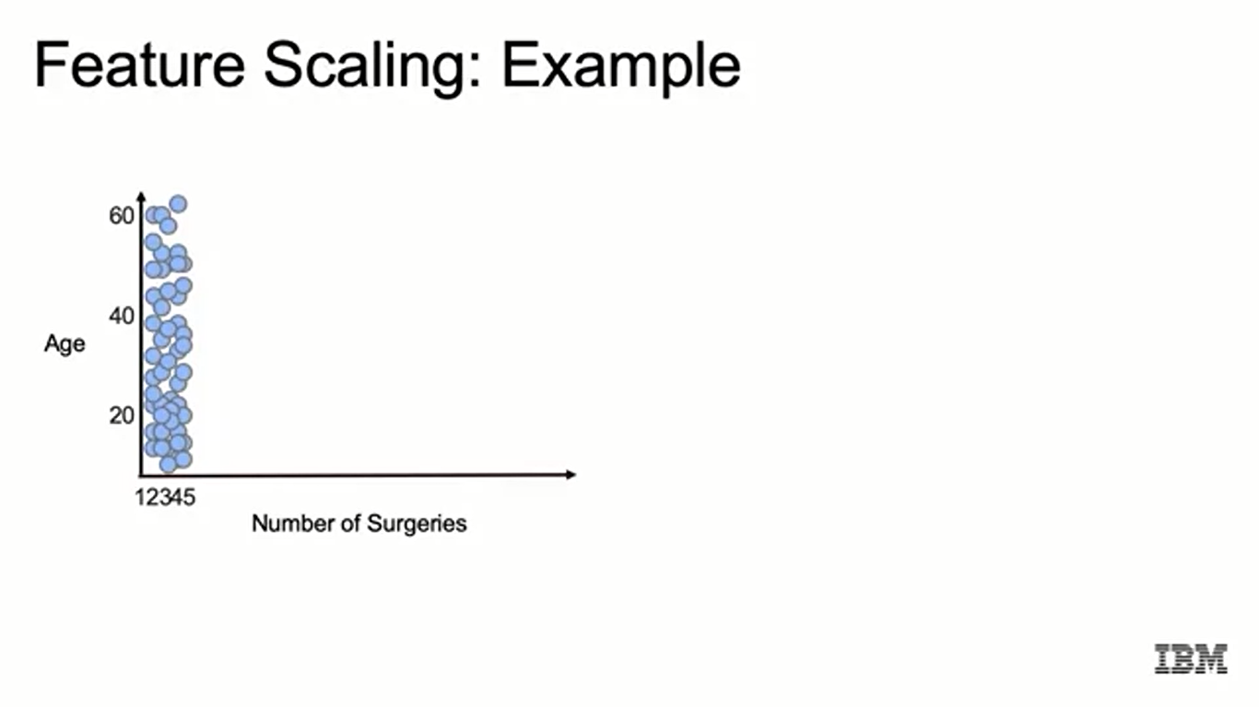
Feature Scaling: Example

Slide 17
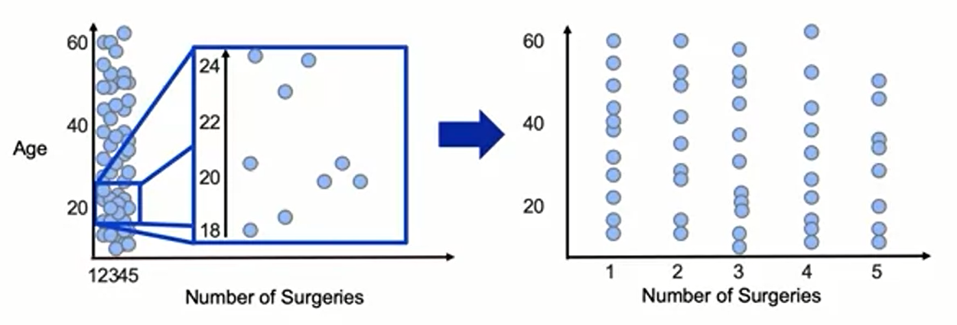
Feature Scaling: Example

Slide 18
Feature Scaling: Approaches
There are many approaches to scaling features.
Some of the more common approaches include:
- Standard scaling: converts features to standard normal variables
(by subtracting the mean and dividing by the standard error).
- Min-max scaling: converts variables to continuous variables in the (0, 1) interval
by mapping minimum values to 0 and maximum values to 1.
This type of scaling is sensitive to outliers.
- Robust scaling: is similar to min-max scaling, but instead maps the interquartile range (the 75th percentile value minus the 25th percentile value) to (0,1).
This means the variable itself takes values outside of the (0, 1) interval.

Slide 19
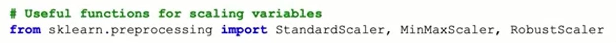
Common Variable Transformations
Feature Type
Continuous: numerical values
Transformation
- Standard, Min-Max, Robust Scaling

Slide 20
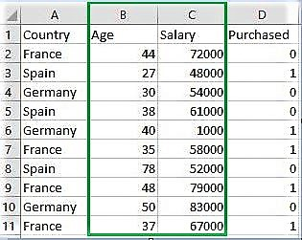
Example of Standard and Min-Max

Slide 21
Example of Standard and Min-Max
""“ Handling the missing values """
from sklearn import preprocessing
""" MIN MAX SCALER """
min_max_scaler = preprocessing.MinMaxScaler(feature_range =(0, 1))
# Scaled feature
x_after_min_max_scaler = min_max_scaler.fit_transform(x)
print ("\nAfter min max Scaling : \n", x_after_min_max_scaler)
""" Standardisation """
Standardisation = preprocessing.StandardScaler()
# Scaled feature
x_after_Standardisation = Standardisation.fit_transform(x)
print ("\nAfter Standardisation : \n", x_after_Standardisation)

Slide 22
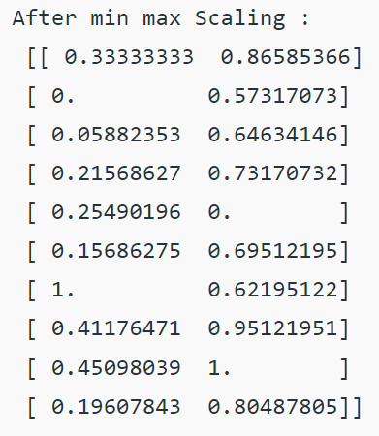
Example of Standard and Min-Max
Output:

Slide 23
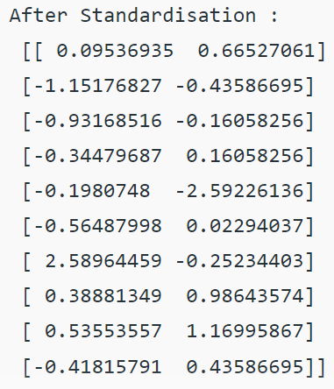
Example of Standard and Min-Max
Output:

Slide 24
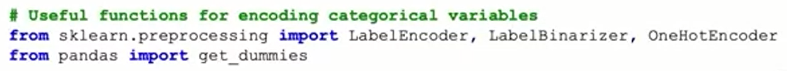
Common Variable Transformations
Feature Type
Continuous: numerical values
- Nominal: categorical, unordered features (True or False)
Transformation
- Standard, Min-Max, Robust Scaling
- Binary, One-hot Encoding (0, 1)

Slide 25
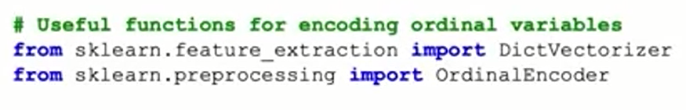
Common Variable Transformations
Feature Type
Continuous: numerical values
- Nominal: categorical, unordered features (True or False)
- Ordinal: categorical, ordered features (movie ratings)
Transformation
- Standard, Min-Max, Robust Scaling
- Binary, One-hot Encoding (0, 1)
- Ordinal Encoding (0, 1, 2, 3)

Slide 26
Common Variable Transformations
Categorical features are generally divided into 3 types:
A. Binary: Either/or
Examples:
Yes, No
True, False
B. Ordinal: Specific ordered Groups.
Examples:
low, medium, high
cold, hot, lava Hot
Nominal: Unordered Groups. Examples
Examples:
cat, dog, tiger
pizza, burger, coke

Slide 27

Example of Encoding
Assume that we apply Label Encoding on iris dataset on the target column which is Species. This column contains three species Iris-setosa, Iris-versicolor, Iris-virginica.
# Import label encoder
from sklearn import preprocessing
# label_encoder object knows how to understand word labels.
label_encoder = preprocessing.LabelEncoder()
# Encode labels in column 'species'.
df['species']= label_encoder.fit_transform(df['species'])
df['species'].unique()
Output:

Slide 28
Summary
Feature Engineering and Variable Transformation
Transforming variables helps to meet the assumptions of statistical models. A concrete example is a linear regression, in which you may transform a predictor variable such that it has a linear relation with a target variable.
Common variable transformations are: calculating log transformations and polynomial features, encoding a categorical variable, and scaling a variable.

Slide 29
Learning Recap
In this section, we discussed:
- Feature engineering and variable transformation
- Feature encoding
- Feature scaling

